Slide 1
<
>
https://doscoyotes.com/
Market Model Presentation
Notes:
Cover

Slide 2
Analysis (Based on Assumptions)
FIRST STEP: Calculating the Number of Annual Visits
Calculation 1: Using visit assumptions, calculate the daily visits for weekdays
11am - 2pm (3 hours)
25 / hour
75 visits
2 – 4pm (2 hours)
15 / hour
30 visits
4 – 8:30pm (4.5 hours)
30 / hour
135 visits
11a–8:30p (9.5 hours)
~24/ hour
240 visits / day
Calculation 2: Using visit assumptions, calculate the daily visits for weekends
11am - 2pm (3 hours)
30 / hour
90 visits
+
2 – 4pm (2 hours)
15 / hour
30 visits
4 – 8:30pm (4.5 hours)
35 / hour
158 visits
Saturday – Sunday
278 visits / day
Calculation 3: Sum the number of total weekly assumptions and convert to annual
Weekly Average
1200 + 556 =
1756 visits weekly
Annual Average
1756 x 52 =
91,312 visits annually
Weekdays:
240 visits x 5
= 1200 visits
Weekends:
278 visits x 2
= 556 visits
Notes:
When looking at annual visits, we determined there would be about 240 visits a day during weekdays with the most visits occurring from 4 to 8:30pm. During these 4.5 hours before closing, Dos Coyotes has about 135 visits. On weekends this number increase to 158 visits during this same 4.5 hour period and also increases to 278 daily visits.
Overall, this leads to about 1756 weekly visits and 91,312 annual visits!

Slide 3
91,312 Annual Visits
DD
DD
10% = 9,131
Notes:
Leading to our 10% target of 9,131 visits

Slide 4
Converting Visits to a Discrete Number of Customers
SECOND STEP: Calculate the Number of Customers
FIRST: Assume you have multiple categories of customers. Identify them by name.
Loyalists
Regulars
Infrequents
Transients
SECOND: Assign the frequency that each customer category visits on an annual basis
RFM DATA
Loyalists
36x per year
Regulars
24x per year
Infrequents
12x per year
Transients
1 x per year
THIRD: Assign the percent of visits by each customer category
RESEARCH DATA
Loyalists
15% of visits
Regulars
27% of visits
Infrequents
31% of visits
Transients
27% of visits
Notes:
Looking at our Data we found, Loyalists make up 15% of our overall customers while Infrequents make up the majority of our customers at 31%. Both Regulars and transients each make up 27% of our visits.

Slide 5
Analysis
Categories of Visitors | % of Visits By Category | Frequency Per Year | # of Visits by Category | # of Customers by Category | Avg $ spend per visit | Total Spend per Category
Loyalists | 15% | 36 | 13,697 | 381 | $17 | $232,849
Regulars | 27% | 24 | 24,654 | 1,028 | $22 | $542,388
Infrequents | 31% | 12 | 28,307 | 2,359 | $15 | $424,605
Transients | 27% | 1 | 24,654 | 24,654 | $12 | $295,848
Totals | 100% | --- | 91,312 | 28,422 | $16.50 | $1,495,690
+ 10% | --- | --- | 9,131 | --- | $1.65 | $149,569
Notes:
This is our breakdown, overall we want a 10% increase from each category in order for our business to increase their revenue form $1,495,690 to a total of $1,609,259

Slide 6
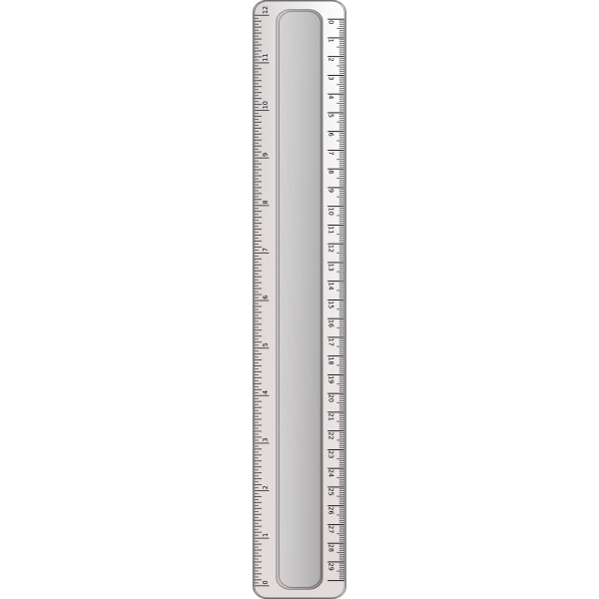
Our Calculations
Total number of current visits: 91,312
Total number of new visits needed to meet objectives: 9,131
Total number of new customers needed to meet objectives: 2,842
Total revenue currently generated by the business: $1,495,690
Net new revenue needed to meet the business objectives: $149,569
Which category or categories will you focus on to meet objectives:
Infrequents
Regulars
Notes:
Based on our calculations, we need 2,842 new customers in order to meet our objectives. As a result, we decided to focus on our Infrequent and regular customers in order to improve our forecasted number of visits and generate new revenue.

Slide 7
Example: Marketing Objectives Framework
Objective 1 (O¹)
9,131 NEW visits / transactions year over year
1
Objective 2 (O²)
$149,569 NEW revenues year over year
2
Target Audience
College Student Collin
3
Target Verticals
Loyalists
Infrequents
Transients
4
Regulars
O¹: Number of New Visits
N/A
1,801
7,331
N/A
5
O²: Total New Revenues
N/A
$39,622
$109,965
N/A
6
Marketing Problem You Will Need To Address
More menu items, with more reasonable prices for the value
Awareness of offerings and why they should buy, prefer better value and higher quality comparing to the competitor
No Actions
No Actions
7
Notes:
Overall, our goal is to increase both the yearly visits and yearly revenue by 10%.
To do this, we are targeting College Student Collin focusing on regular and infrequent customers.
In order to achieve this goal, we need to address awareness and increase variety. By adding more menu items and increasing the value for the price, regulars are more likely to transition into loyalists. Additionally, by generating more awareness and highlighting this improved value, infrequents would also choose Dos Coyotes as opposed to their competitors becoming regular customers.

Slide 8
<
>
https://doscoyotes.com/
Market Model Presentation
Questions?
Notes:
Questions?

